Slide 1
Restaurant management system
CAPSTONE PROJECT
Presented By:
P Sakthivel - 2021311001
Department of Applied Science And Technology
ACTech , Anna University.

Slide 2
OUTLINE
Problem Statement
Proposed System/Solution
System Development Approach
Algorithm & Deployment
Result
Conclusion
Future Scope
References

Slide 3
Problem Statement
The current manual billing process results in delays for customers and operational inefficiencies within the organization, signaling a need for improvement. Transitioning to a computer-based billing system could optimize resource utilization. This system facilitates streamlined data entry for client, employee, and payment information, enhancing record management and meeting organizational data requirements. Key issues with the current method include:-
Limited flexibility for data modification-
Dependence on manual operator oversight-
Excessive paper consumption-
Difficulty in accessing information promptly-
Challenges in maintaining systematic records-
Paper waste

Slide 4
Proposed Solution
The Restaurant Management System (RMS) is a digital solution designed to streamline restaurant billing, providing a faster and more user-friendly experience. With this system, restaurant staff can process customer bills quickly, leading to shorter wait times. RMS is capable of handling large datasets, efficiently managing information such as billing history, reservation details, and staff records.
As a desktop-based software, RMS is designed with simplicity in mind, reducing the need for paperwork. It automates tasks like bill calculation and applying discounts, which speeds up the billing process and minimizes errors. All information is securely stored in a database, reducing the risk of data loss and eliminating the need for manual record-keeping. By using RMS, restaurants can improve operational efficiency and create a smoother customer experience by automating key processes like billing and reservations.

Slide 5
System Approach
Creating a Python-based restaurant management system involves a structured process, outlined in the following steps:
*Requirement Elicitation*: Initiate by gathering and understanding the system's requirements thoroughly. This includes delineating needs such as menu composition, order processing workflows, reservation handling intricacies, inventory management specifics, and comprehensive reporting functionalities.
*Architectural Blueprinting*: Develop a blueprint for the system's architecture, focusing on modularity and scalability. Segment the system into cohesive modules, each dedicated to specific functions like Menu Management, Order Processing, Reservation Handling, Inventory Control, and Reporting.
*Class Design and Abstraction*: Design and abstract classes within each module to encapsulate entities and actions effectively. Construct hierarchical class structures to represent system components such as Menu Items, Orders, Reservations, and Inventory Items, fostering flexibility and maintainability.
*Relationship Establishment*: Establish relationships between classes and modules to ensure seamless interactions. Define how orders relate to menu items, how inventory levels adjust based on orders, and how reservations integrate into operational workflows.

Slide 6
System Approach
*Functional Implementation*: Implement functions and methods within each module to execute tasks efficiently. Develop algorithms for menu updates, streamlined workflows for order processing, inventory management strategies, and reservation handling processes to ensure smooth operation.
*User Interface Development*: Design an intuitive and user-friendly interface tailored to user needs. Whether opting for a command-line interface, a graphical interface using Tkinter or PyQt, or a web-based interface with Flask or Django, prioritize usability and accessibility.
*Thorough Testing and Optimization*: Conduct comprehensive testing to validate system functionality and performance. Iterate on the system based on testing feedback and insights to optimize its efficiency and reliability.
*Documentation and Knowledge Transfer*: Document the system comprehensively, providing insights into its architecture, functionalities, and usage guidelines. Ensure clear and concise documentation to facilitate knowledge transfer and support future maintenance and enhancements.

Slide 7
Algorithm & Deployment
Revised Outline for Restaurant Management:
*Streamlined Menu Management:* - Develop a structured menu item class with key details like name, price, and description. - Create a dedicated system to efficiently manage menu items, enabling easy addition, removal, and display.
*Efficient Order Processing:* - Establish a robust order framework featuring essential attributes such as order ID, selected items, and total price. - Implement functionalities for seamless addition of items, accurate price calculation, and smooth order processing.
*Seamless Reservation Handling:* - Define a reservation entity with vital details including reservation ID, customer name, date, and table. - Implement a reservation management system facilitating reservation creation, availability checks, and cancellations.
*Effective Inventory Control:* - Introduce an inventory structure with key attributes such as item name, quantity, and price. - Develop comprehensive inventory management functionalities for stock addition, quantity updates, and low stock alerts.

Slide 8
Algorithm & Deployment
*Insightful Reporting Tools:* - Incorporate reporting capabilities to generate tailored reports like sales and inventory reports based on user needs.
*User-Friendly Interface Design:* - Design an intuitive interface for seamless interaction, offering options like command-line, web-based, or GUI interfaces.
*Flexible Deployment Options:* - Explore various deployment methods including local deployment with PyInstaller, web-based deployment with Flask or Django, mobile app deployment with Kivy or React Native, containerization with Docker, and hybrid deployment for comprehensive coverage.

Slide 9
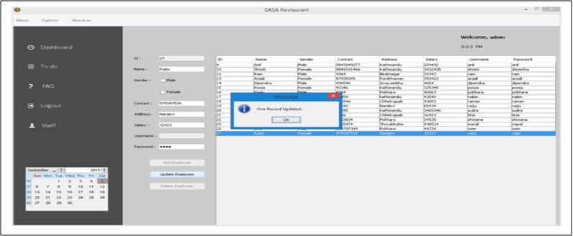
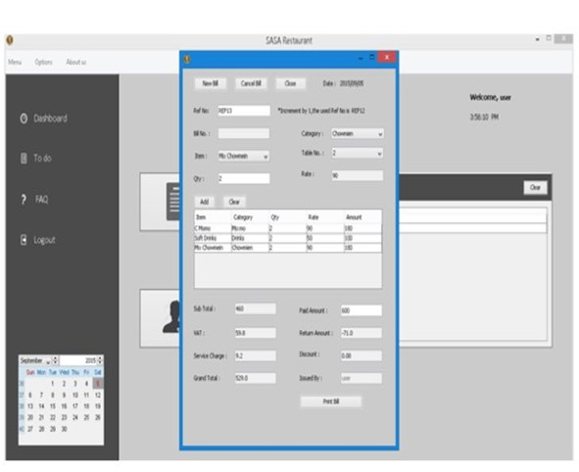
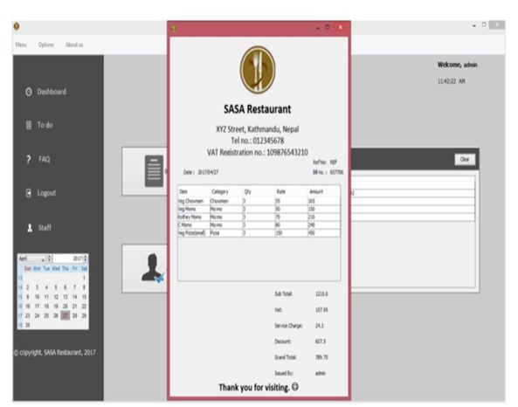
Result
Assessing the Restaurant Billing System's functionality, it adeptly manages staff data, customer reservations, billing tasks, and more. Upon analysis, the system demonstrates robust features for staff information management, including adding, editing, updating, and deleting records. Additionally, it facilitates reservation creation, cancellation, and bill generation for customers. The system's outputs are visually depicted in the accompanying figure.

Slide 10
Conclusion
The documentation provides a comprehensive guide to the structure and coding of the Restaurant Management system. Building this program was a challenging process, requiring in-depth analysis, extensive research, and a range of technical skills. Writing this report has been a rewarding experience, filled with insights gained from overcoming difficult tasks. Creating a system for a restaurant demanded both research and technical expertise, and ensuring a smooth operational flow required significant time and effort.
Despite the obstacles, the system was completed with a solid design and smooth workflow. The billing system was the most challenging part. Retrieving data from the database for billing required complex SQL queries, involving multiple database changes, which was both time-consuming and required careful planning.
Overall, this project provided significant coding experience and underscored the importance of effective time management and teamwork in software development.

Slide 11
Future scope
Restaurant management software (RMS) provides an extensive toolkit for efficiently managing various aspects of restaurant operations. Covering tasks like staff management, order processing, billing, menu updates, reservation handling, and more, it offers a comprehensive solution. Looking ahead, there's ample opportunity for further improvement. Enhancements such as advanced inventory control, wireless tableside ordering and payment systems, real-time alerts, online ordering integration, and mobile management capabilities hold the promise of enhancing revenue streams and operational efficiency.

Slide 12
References
Restaurant Billing System: https://www.scribd.com/doc/283903672/Online-Ordering-System-
Project Objective : https://www.scribd.com/document/36253350/04-Project-Billing-
System Scopes and Limitation: https://kungfumas.files.wordpress.com/2017/09/099.pdf
Feasibility study: http://www.slideshare.net/alok104/synopsis-on-billing-system-27487568
UML Diagram : https://www.techopedia.com/definition/3243/unified-modeling-language-uml/
Use Case Diagram: http://whatis.techtarget.com/definition/use-case-diagram
Class Diagram: http://searchmicroservices.techtarget.com/definition/class-diagram
Sequence Diagram : https://creately.com/blog/diagrams/sequence-diagram-tutorial/
ER Diagram: http://searchcrm.techtarget.com/definition/entity-relationship-diagram
Interfaces : https://www.youtube.com/watch?v=9K5sS7j5wWI

Slide 13
THANK YOU

